Slide 1
ALOHA 2주차 강의
Theme : breadth-first search and depth-first search

Slide 3
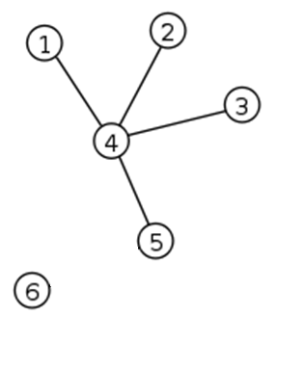
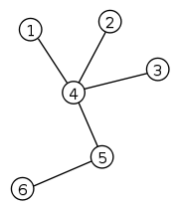
Tree | Graph
Graph
set of objects where some objects are connected by links.
Tree
undirected graph in which any two vertices are connected by exactly one path.
Forest
Undirected graph, all of whose connected components are trees.
Connected component A
Connected component B

Slide 4
Tree | Graph
Graph
set of objects where some objects are connected by links.
Tree
undirected graph in which any two vertices are connected by exactly one path.
Forest
Undirected graph, all of whose connected components are trees.
Connected component A
(not tree)
↓
Not forest
Connected component B

Slide 5
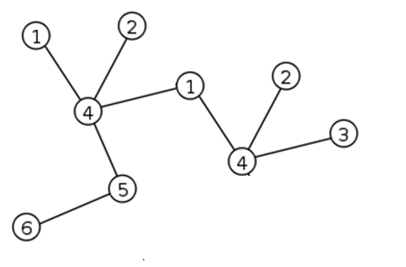
Traversal algorithm ( dfs )
Tree
undirected graph in which any two vertices are connected by exactly one path.
시작 노드로부터 각 목표 노드까지의 최단 거리 * 노드의 weight 를 곱한 값의 총 합이 최소인 시작 노드를 찾아라.
int sum;
int weight[110];
int visit[110];
vector<int> adjacent_node[110];
Start node
노드 안의 수는
노드가 가진 정보 (o)
노드 번호 (x)

Slide 6
Traversal algorithm ( dfs )
Tree
undirected graph in which any two vertices are connected by exactly one path.
시작 노드로부터 각 목표 노드까지의 최단 거리 * 노드의 weight 를 곱한 값의 총 합이 최소인 시작 노드를 찾아라.
int sum;
int weight[110];
int visit[110];
vector<int> adjacent_node[110];
Start node
노드 안의 수는
노드가 가진 정보 (o)
노드 번호 (x)

Slide 7
Traversal algorithm ( dfs )
Tree
undirected graph in which any two vertices are connected by exactly one path.
시작 노드로부터 각 목표 노드까지의 최단 거리 * 노드의 weight 를 곱한 값의 총 합이 최소인 시작 노드를 찾아라.
int sum;
int weight[110];
int visit[110];
vector<int> adjacent_node[110];
int dfs(int node,int depth) {
visit[node] = true;
sum += weight[node] * depth;
for (auto i : adjacent_node[node] )
if(!visit[i])
dfs(i,depth+1);
}
Start node
노드 안의 수는
노드가 가진 정보 (o)
노드 번호 (x)

Slide 8
Traversal algorithm ( about graph )
Not tree. It’s Graph.
set of objects where some objects are connected by links.
Tree
undirected graph in which any two vertices are connected by exactly one path.
graph이기 때문에 이 문제는 depth-first search algorithm으로 해결 할 수 없다.
int sum;
int weight[110];
int visit[110];
vector<int> adjacent_node[110];
int dfs(int node,int depth) {
visit[node] = true;
sum += weight[node] * depth;
for (auto i : adjacent_node[node] )
if(!visit[i])
dfs(i,depth+1);
}
Depth 2 (fail)
Start node
Depth 1
노드 안의 수는
노드가 가진 정보 (o)
노드 번호 (x)

Slide 9
Traversal algorithm ( bfs )
Tree
undirected graph in which any two vertices are connected by exactly one path.
int sum;
int weight[110];
int visit[110];
vector<int> adjacent_node[110];
// in main function
queue<pair<int, int>> qu;
qu.push({ start,0 });
visit[start] = true;
while (!qu.empty()) {
pair<int, int> pos = qu.front();
int node_number = pos.first;
int depth = pos.second;
sum += weight[node_number]*depth;
qu.pop();
for (auto i : adjacent_node[node_number])
if (!visit[i]){
visit[i]= true;
qu.push({ i,depth + 1 });
}
}
1260
Just print when visited
Start node
노드 안의 수는
노드가 가진 정보 (o)
노드 번호 (x)

Slide 10

Traversal algorithm ( about forest )
Tree
undirected graph in which any two vertices are connected by exactly one path.
Forest
Undirected graph, all of whose connected components are trees.
Forest check available
노드 안의 수는
노드가 가진 정보 (o)
노드 번호 (x)

Slide 11
Traversal algorithm ( about forest )
graph
set of objects where some objects are connected by links.
Forest
Undirected graph, all of whose connected components are trees.
11724
Just linearly call search algorithm
2667
Just linearly call search algorithm
Forest check available
Also for graph, it’s ok
노드 안의 수는
노드가 가진 정보 (o)
노드 번호 (x)

Slide 12
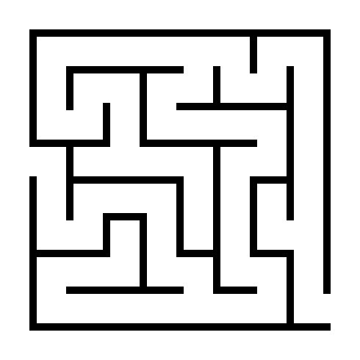

Maze problem
EXIT
ENTRANCE

Slide 13
Maze problem
EXIT
ENTRANCE

Slide 14
Maze problem
EXIT
ENTRANCE

Slide 15
Maze problem
EXIT
ENTRANCE

Slide 16
Maze problem
EXIT
ENTRANCE

Slide 17
Maze problem
EXIT
ENTRANCE

Slide 18
Maze problem
1. Check whether we can reach exit
Use bfs or dfs
2. Route tracing
Use dfs and if reached, print current location and then return.
(갈 곳이 없다면 return false)
-2178
shortest path
Use bfs
-1726
가장 귀찮은 경로찾기 문제
-2206
벽 부수고 이동하기
Use dfs
벽을 부수는 경우 그 경우로 끝까지 search 하고서 돌아 왔을 경우에는 벽을 다시 지어줘야 한다.
(1,1)
(1,2)
(1,8)
(2,1)
EXIT
If not connected

Slide 19


sw test
Number of testcase is given.
N X N cell ( N up to 20 )
There is start point (x_{s}, y_{s})
There is end point (x_{e}, y_{e})
Each cell has direction.
▷(1) ▽(2) ◁(3) △(4)
The direction rotates in clockwise every second.
we can go to another location only if two direction triangles face each other.
Or we can stay.
Q. print minimal time we can go from start point to the end point for each test case in format printf(“#%d : %d\n”,Testcase,result);

Slide 20
sw test
original
After one second
After two second

Slide 21
sw test
Input example
output example
2
4
2 3
2 4
4 4 4 1
2 1 3 1
4 4 2 2
3 2 1 4
2
1 1
2 2
1 3
3 1
#1 : 3
#2 : 3

